Slide 1
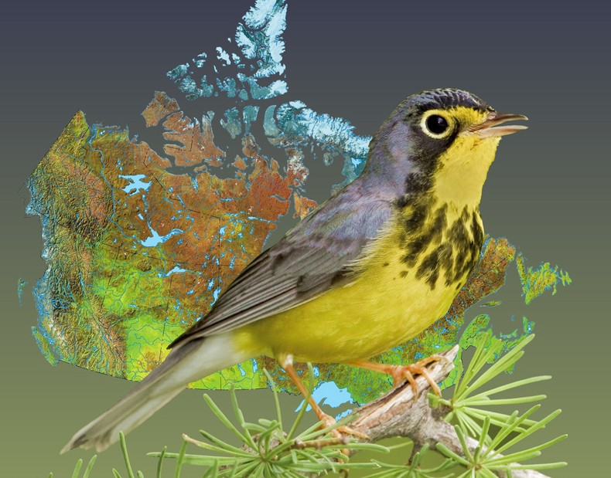
We Fly Together Connections between the Bird-feeding Industry and Bird Groups in North America
Birds, bytes and breakthrough technology
Birds, bytes and breakthrough technology
Birds, bytes and breakthrough technology
Steven Price
President

Slide 2
Bird Feeding Enthusiasts!
Bird Feeders
Bird Enthusiasts
Notes:
Bird groups and wild bird feed industry share the same audience.

Slide 3
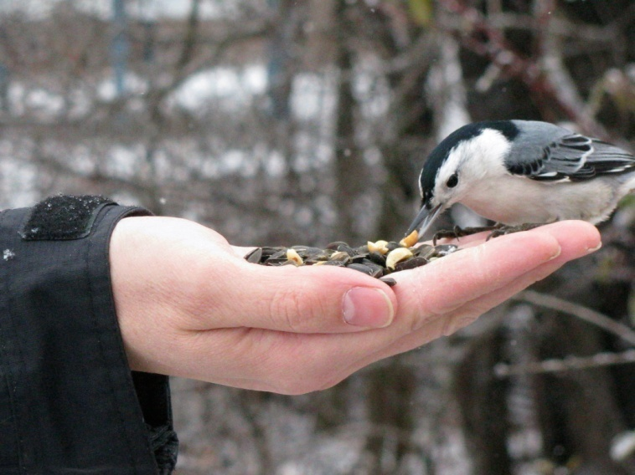
PRESENTATION
SUMMARY
What is Bird Studies Canada?
Our common audience
Benefits and Challenges of Bird Feeding
What have I learned from 30 years of conservation partnership with business?

Slide 4
PRESENTATION
SUMMARY
What is Bird Studies Canada?
Our common audience
Benefits and Challenges of Bird Feeding
What have I learned from 30 years of conservation partnership with business?

Slide 5
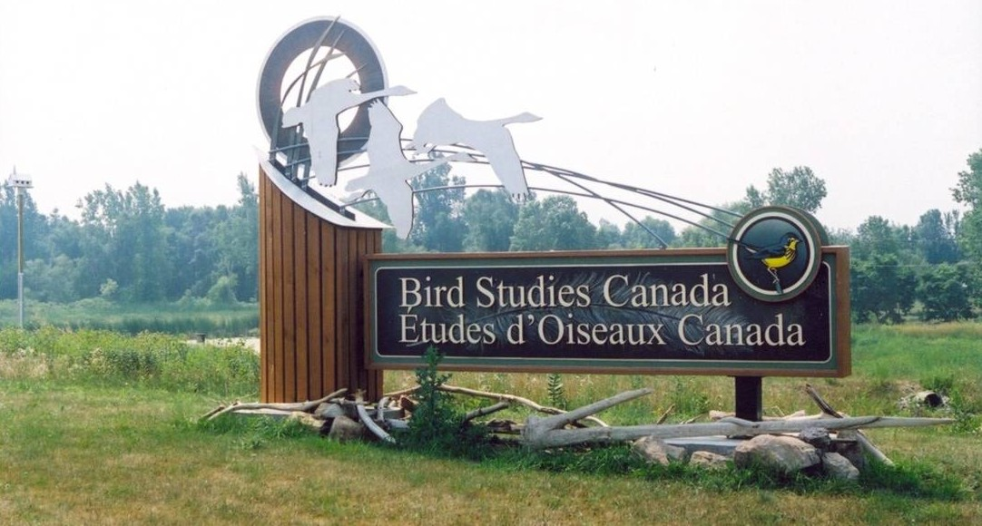
Canada’s national charity for bird science and conservation
Notes:
Port Rowan, ON, is national HQ; regional offices in Atlantic Canada, QC, MB, SK, BC. We report to a Board of Directors (15 members) and a National Science Advisory Council (10). Operating budget over $5 million annually.

Slide 6
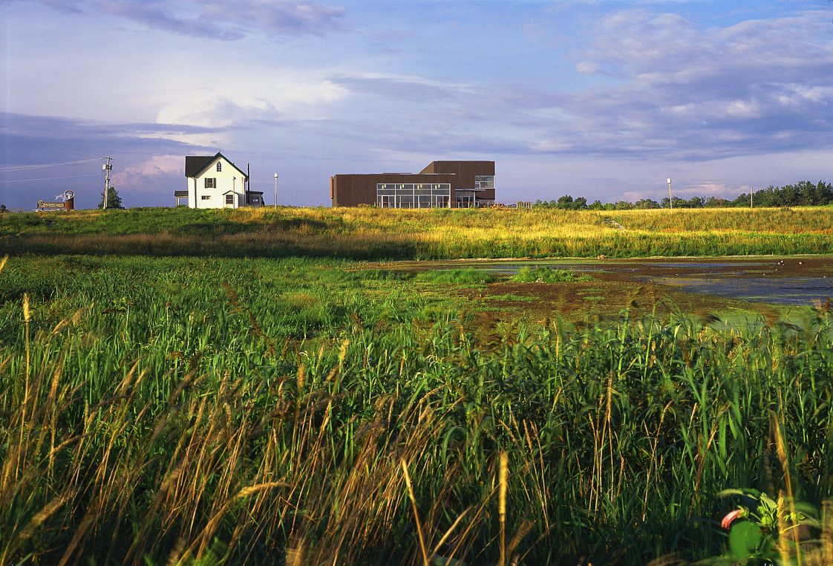
BSC’s Mission
Understand
Appreciate
Conserve
Notes:
Bird Studies Canada’s mission is to conserve wild birds of Canada through sound science, on-the-ground actions, innovative partnerships, public engagement, and strategic informed advocacy.

Slide 7
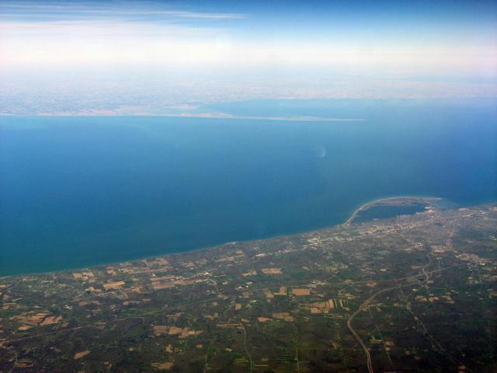
Notes:
View over Lake Erie of Long Point (Canada) from Erie, PA.

Slide 8
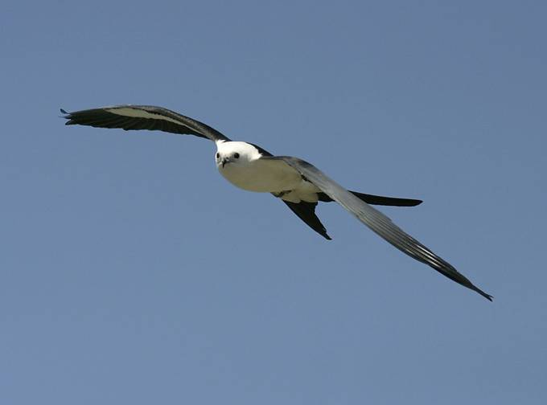
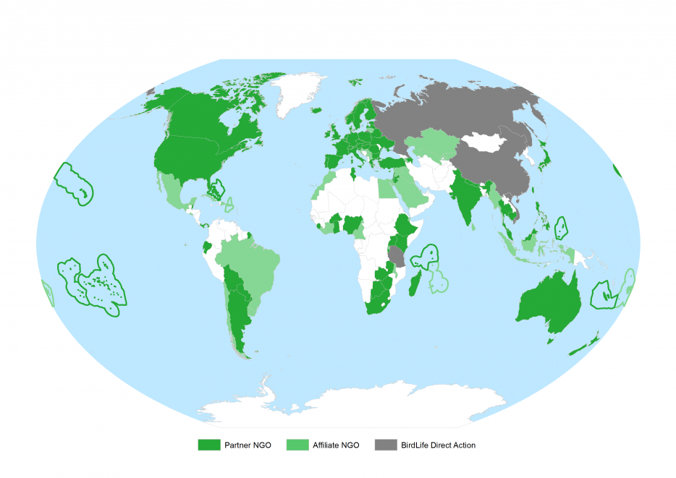
BirdLife Partner
Notes:
We have a wide range of international, national, regional, and local programs. We are a strong partner in BirdLife International, the world’s largest conservation alliance for nature and people.

Slide 9
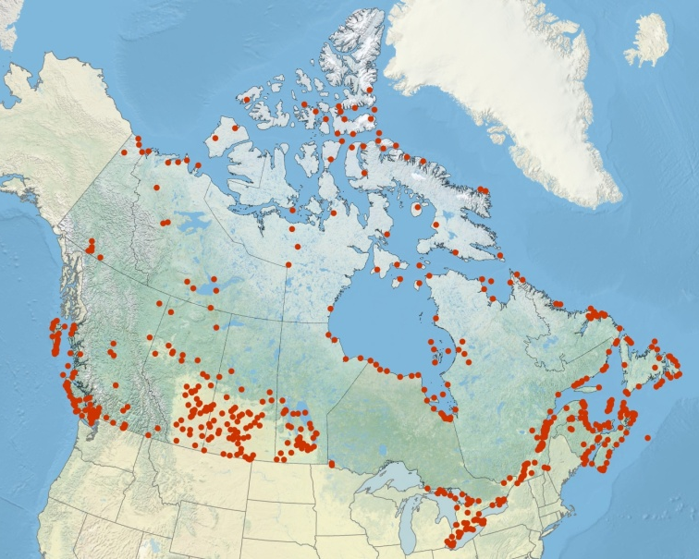
Important Bird Areas
Strengthening scientific credibility
Supporting a network of local stewards
www.ibacanada.org
Notes:
Our habitat focus is Important Bird Areas

Slide 10
Notes:
BSC is in partnership with the documentary film about birds “The Messenger”

Slide 11
Notes:
We’re one of the six NABCI-Canada steering committee partners who collaborated on preparing the first-ever State of Canada’s Birds report, which showed the strong influence of human activity on bird populations over the last 40 years. Key findings: aerial insectivores, grassland birds, and Arctic-nesting shorebirds have declined dramatically since 1970, while some waterfowl and raptor populations are rebounding thanks to conservation efforts.

Slide 12
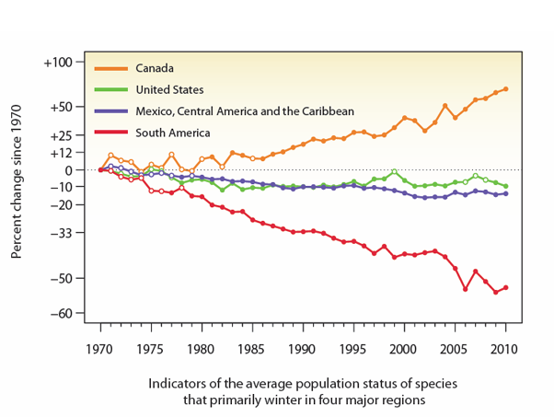
Notes:
Bird trends vary

Slide 14
PRESENTATION
SUMMARY
What is Bird Studies Canada?
Our common audience
Benefits and Challenges of Bird Feeding
What have I learned from 30 years of conservation partnership with business?

Slide 15
Bird Feeding Enthusiasts!
Bird Feeders
Bird Enthusiasts
Notes:
Bird groups and wild bird feed industry share the same audience.

Slide 16
Why Do People Feed Birds?
Fun to do
Provides a touch of nature
Believe it helps birds
Contribute to science

Slide 17
Citizen Scientists
Notes:
More than 30,000 volunteer ‘Citizen Scientists’ throughout the country, of all ages and birding skill levels, participate in Bird Studies Canada’s programs annually. Through monitoring activities and targeted surveys, these volunteers submit data that helps us detect trends in bird populations.

Slide 18
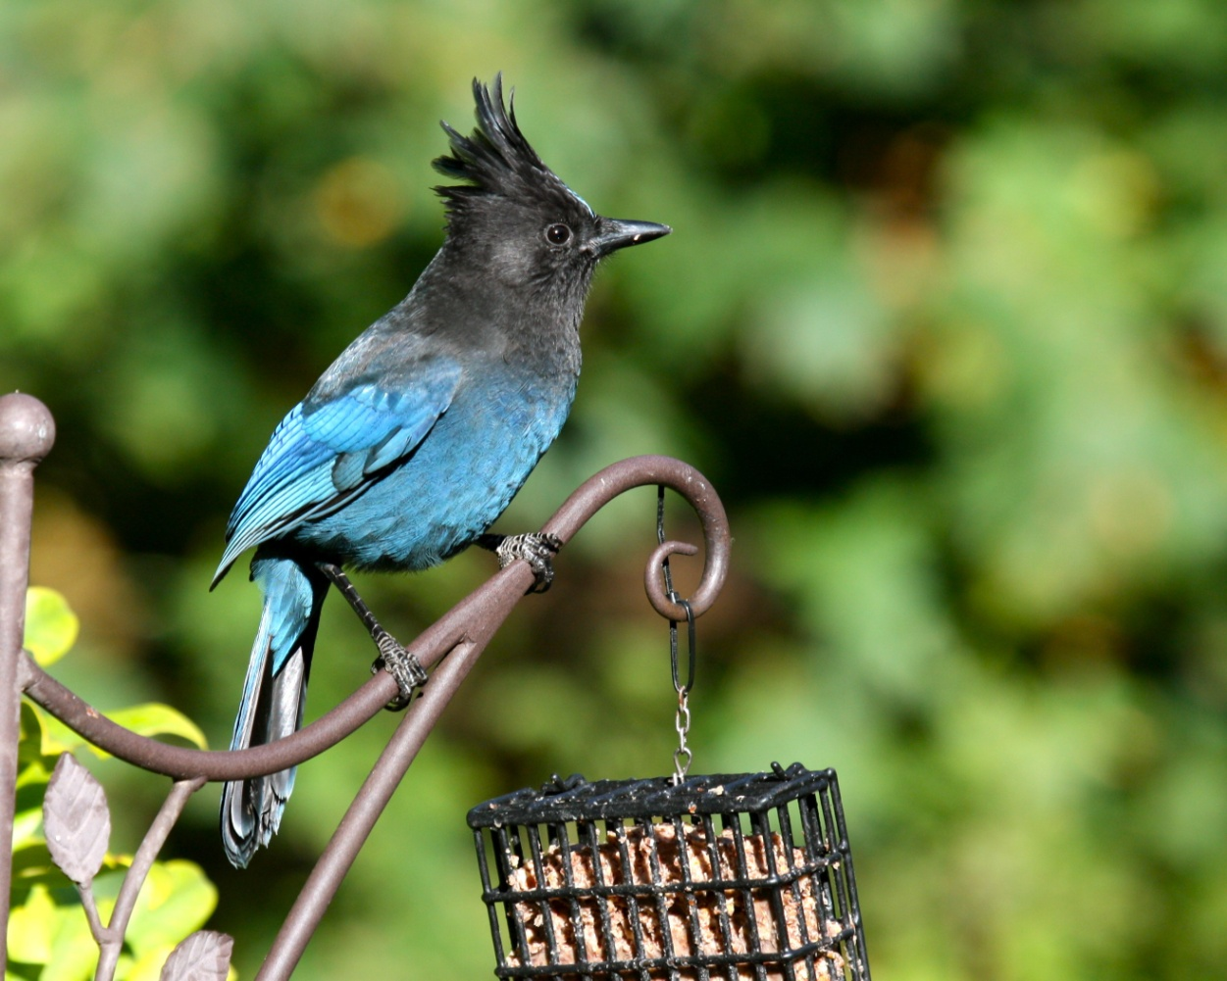
Project Feeder Watch
Notes:
Every winter between November and May, participants count the kinds and numbers of birds at their feeders at regular intervals and submit their observations to us, to help scientists study winter bird populations. Our organization founded Project FeederWatch in 1976. There are now more than 3000 FeederWatchers across Canada. The program expanded to cover all of North America in 1987. In the US, the program is administered by our partner, the Cornell Lab of Ornithology.

Slide 19
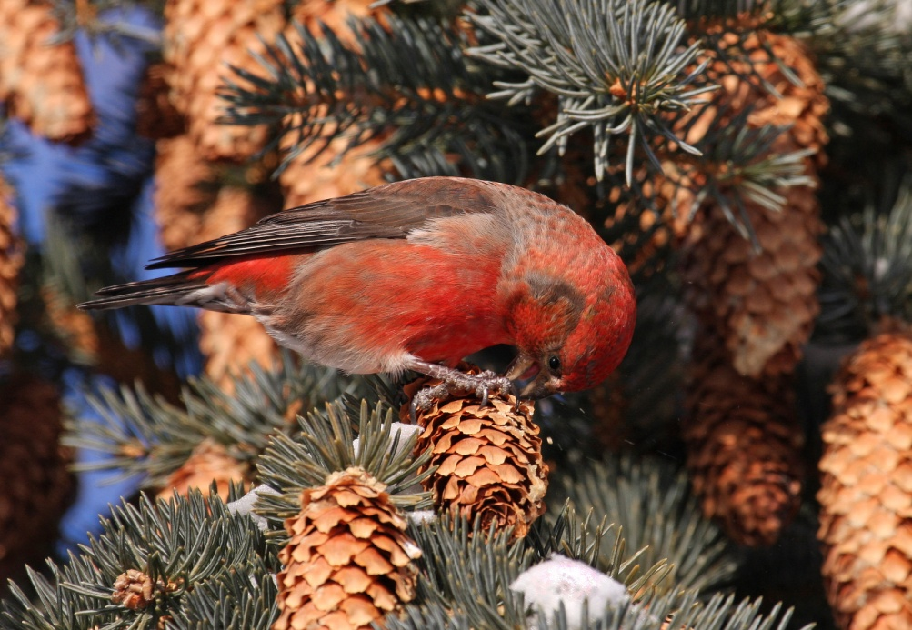
Christmas Bird Count
* CBC4Kids
Notes:
The CBC takes place between Dec. 14-Jan. 5 each year at over 2000 locations throughout the Americas. Groups of organized participants conduct one-day winter bird counts in designated areas. Tens of thousands of volunteers participate annually. Founded in the US by Audubon. BSC has coordinated this program in Canada since 2000. Provides information about trends for birds that winter in Canada.

Slide 20
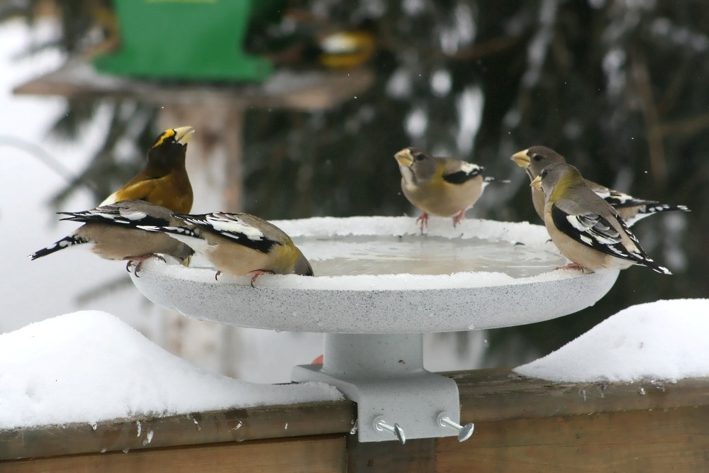
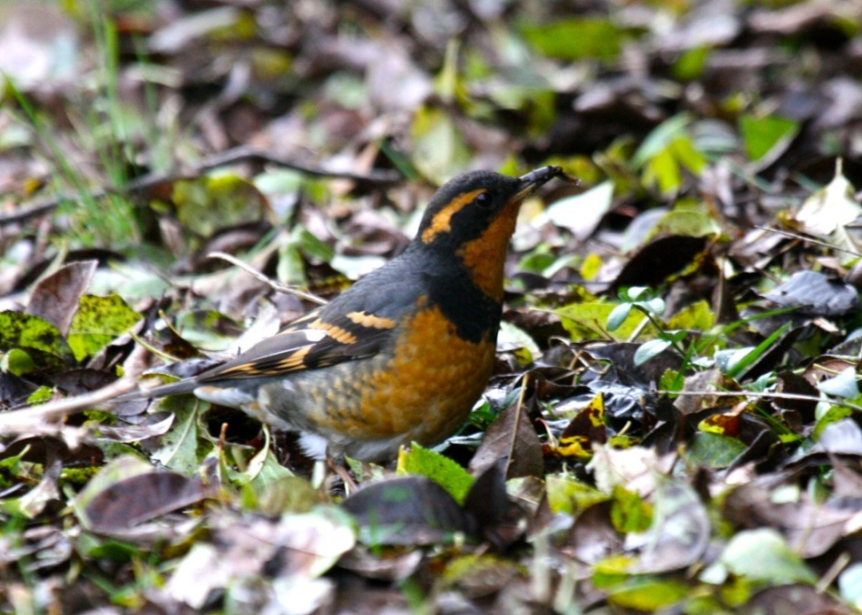
Great Backyard Bird Count
Notes:
Founded in 1998 by the Cornell Lab of Ornithology and Audubon. BSC became the Canadian partner for the program in 2010. A free family-friendly four-day event each February. Tens of thousands of volunteers around the world count birds and submit sightings online to create a snapshot of where the birds are. A great entry-level program, and an ideal way for more experienced birders to introduce novices to the wonderful world of birding. Family Day Canada + Presidents Day U.S.

Slide 21
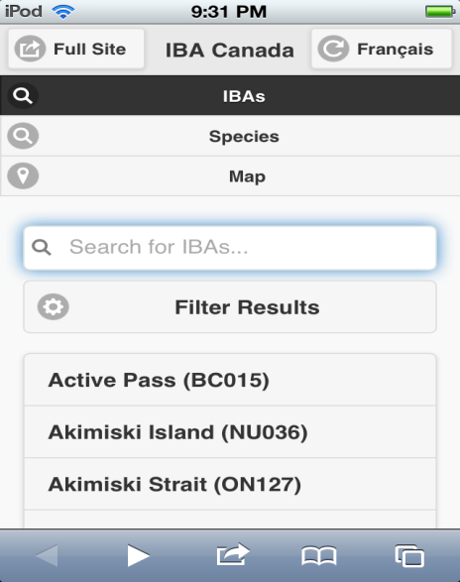
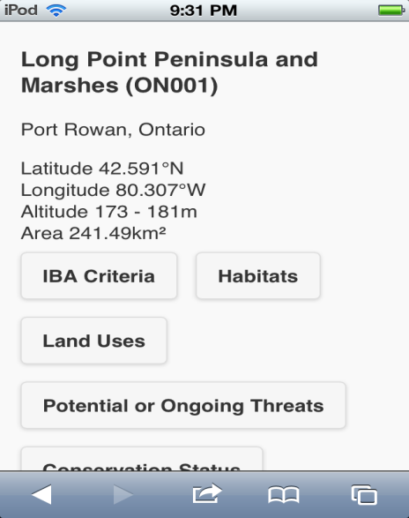
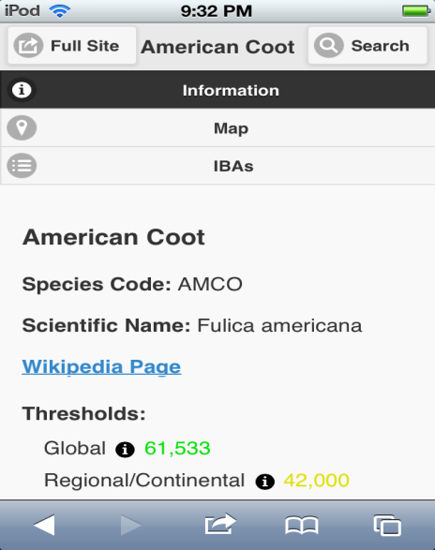
eBird Canada
Notes:
Users can manage sightings online while contributing to a global database. The program was launched by U.S. partners the Cornell Lab of Ornithology and National Audubon Society in 2002. As the Canadian eBird partner, BSC has been managing eBird Canada (at ebird.ca) since 2006. Anyone can contribute their sightings, year-round, or explore the entire database through maps, graphs, and tables.

Slide 22
Canadian Lakes Loon Survey
Notes:
Helps us assess the long-term health of Common Loons and the lakes they depend on. Participants spend time observing loons at their favourite lake throughout the summer. We launched this program in Ontario in 1981; it went national in the early 1990s. Our 2013 report analyzing 32 years of data collected through the program showed significant declines in reproductive success since 1992; pollution is the suspected cause.

Slide 23
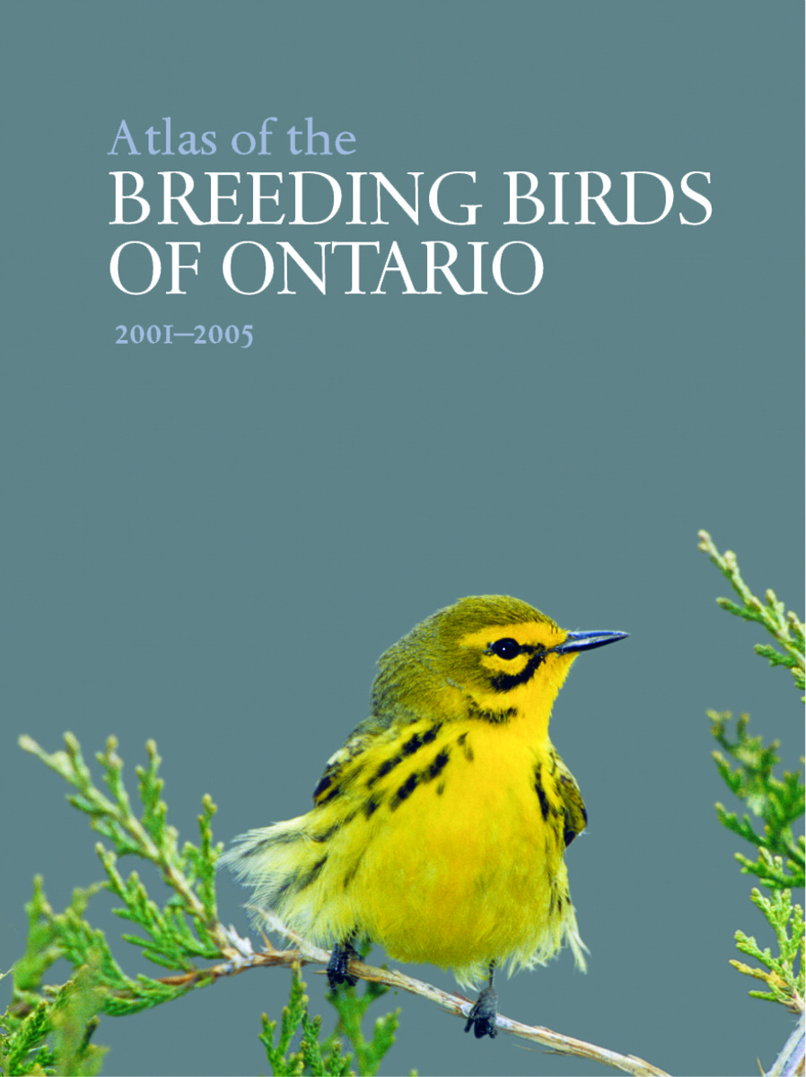
Breeding Bird Atlases
Notes:
In recent years BSC has been coordinating atlas projects in the Maritimes, BC, and Manitoba – and has been a key partner on atlas projects in Ontario and Quebec.

Slide 24
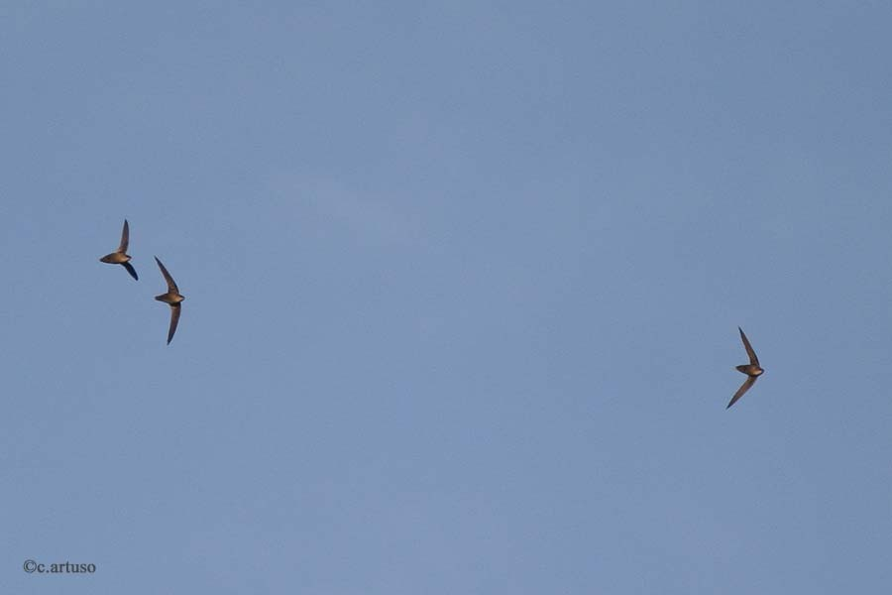
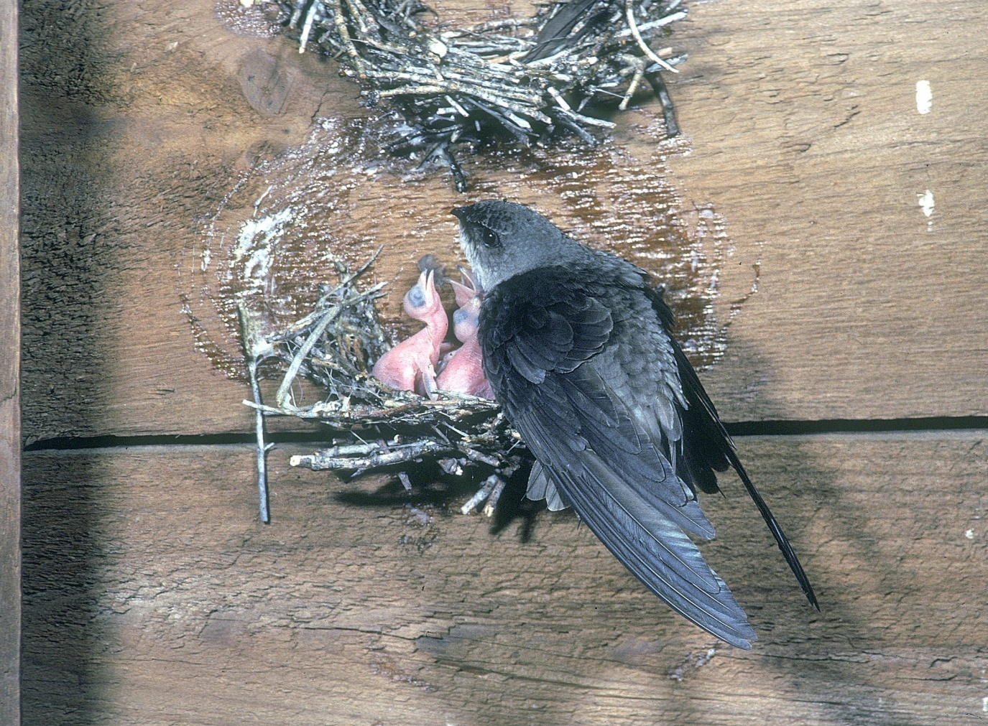
Swift Watch
Chimney Swift
Notes:
BSC coordinates SwiftWatch programs in Ontario and Atlantic Canada. Volunteers find and monitor nesting and roosting habitat for the federally Threatened Chimney Swift, count numbers of birds, and act as urban stewards for active sites within their communities.

Slide 25
Bird Feeding Enthusiasts!
Bird Feeders
Bird Enthusiasts

Slide 26
Notes:
Bird Studies Canada is in partnership with Armstrong Milling to promote Citizen Science projects like Project Feeder Watch.

Slide 27
PRESENTATION
SUMMARY
What is Bird Studies Canada?
Our common audience
Benefits and Challenges of Bird Feeding
What have I learned from 30 years of conservation partnership with business?

Slide 28
Benefits of Bird-feeding
Motivations
Fun to do
Touch of nature
Believe it helps birds
Contribute to science
Benefits
= people engaged
= deeper attachment
= desire to help/conserve
= better data/science
= economic benefits

Slide 29
Challenges to Bird-feeding
Bird-to-bird disease
Bird-to-people disease
May support nest predators
May encourage dependency
We should be feeding people
Impacts from environmental footprint

Slide 30
PRESENTATION
SUMMARY
What is Bird Studies Canada?
Our common audience
Benefits and Challenges of Bird Feeding
What have I learned from 30 years of conservation partnership with business?

Slide 31
Consider 1: How you view Science
Science is not a body of facts
– it’s a stumbling, but self-correcting system to develop, test and improve knowledge.
Be cautious about drawing absolute conclusions
Always remain open to a challenge

Slide 32
Consider 2: How you label bird people!
What to call people interested in birds:
Birders
Citizen Scientists (survey volunteers)
Be careful calling them ‘bird-watchers’!

Slide 33
Consider 3: How you address risks
Adequate habitat
Proper feed
Clean feeders
Little or no pesticides
Absence of cats
Safety from windows

Slide 34
Consider 4: How you address impacts
Every supply chain has environmental impacts.
Acknowledge openly your use of water, energy, material inputs, etc.
Assess the biggest impacts
Begin to take steps to reduce/conserve
Companies open to posting on-line their challenges and actions...
rarely faced boycotts
held/gained market share
had NGOs as friends & mktg partners

Slide 35
Forward-looking risk reduction
Support scientific research
Provide sound information
Acknowledge your impacts
Start to take action

Slide 36
We Fly Together Connections between the Bird-feeding Industry and Bird Groups in North America
Birds, bytes and breakthrough technology
Birds, bytes and breakthrough technology
Birds, bytes and breakthrough technology
Steven Price
President
birdscanada.org

