Slide 1
chamber economics – It does make sense to be a member!
www.chambereconomics.com
Chamber of Commerce
Value of Membership
Network with Locals to do Business
Have your Voice be Heard
Become part of the Area Search Engine
Receive Monthly Marketing and Advertising Reports

Slide 2
chamber economics – It does make sense to be a member!
www.chambereconomics.com
Chamber Delivers Prospects
Your Business Offering
The Chamber Phone and Online Traffic
Business Leads and More Prospective Customers

Slide 3
chamber economics – It does make sense to be a member!
www.chambereconomics.com
Chamber Delivers Traffic
TOOLS
Advanced Traffic Catcher Tools
Advanced Mark LeBlanc Marketing Program
SUPPORT
Unlimited FREE Member Support
US Based Phone Support
TRAFFIC
Chamber Website
Search Engine Optimization Tools
Online Support Desk
Area Search Engine Powered by Google®
Chamber Directory

Slide 4
chamber economics – It does make sense to be a member!
www.chambereconomics.com
Chamber Provides Technology
Join the Chamber of Commerce to be Accepted Into a Powerful Business Development Plan
Invitation to View/Update Membership Record Online
Beautiful and Easy to Use Computer Screens Walk You Through the Setup
Answer Some Easy Marketing Questions
Upload Logo and Some Nice Business Photos and a Scrolling Tour Will be Created
Select a Custom Website and Mobile Phone Domain Name to Activate New System
Beautiful Marketing and Advertising Landing Page Now Created for Your Business
Room for 1000 Advertisements Now Available for your Business Promotion
Unlimited Telephone and Online Support Provided to Members at NO COST!

Slide 5
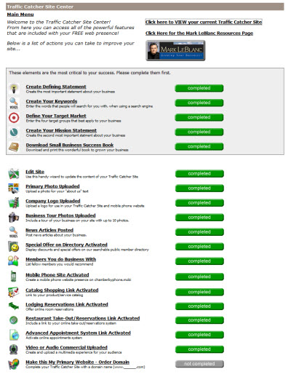
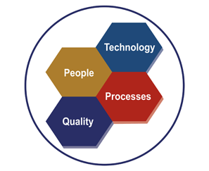
chamber economics – It does make sense to be a member!
www.chambereconomics.com
Chamber Understands “SIMPLE”
The Chamber understands that many of their members have experienced technology hurdles in the past. We promise that this is the simplest, easiest to use system ever that will deliver excellent results. The reports we send to you each month will prove the Chamber value.

Slide 6



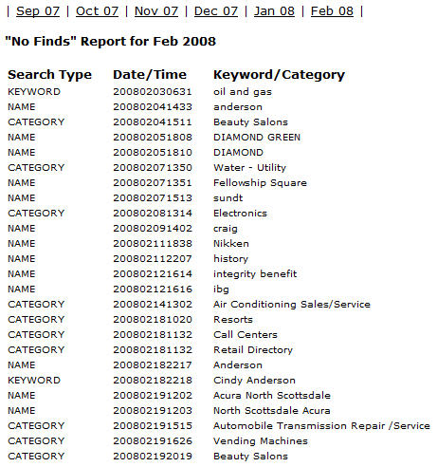
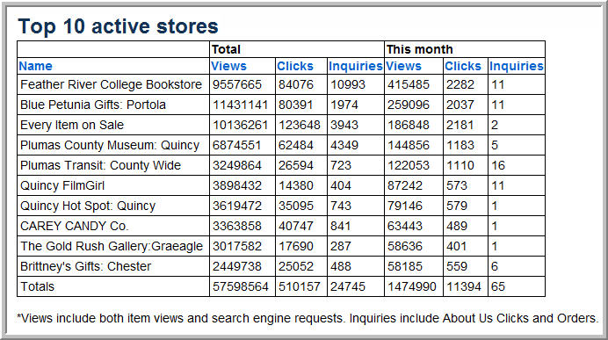
chamber economics – It does make sense to be a member!
www.chambereconomics.com
You’ll always know when someone is looking for something that they can’t find through your member directory.
Members will automatically receive from the Chamber a “Member Statement” Proving the Value of Chamber Membership.
Chamber Executive(s) gain access to a wealth of local search information for newsletters.

Slide 7


chamber economics – It does make sense to be a member!
www.chambereconomics.com
Included business development modules:
  Free copy of “Growing your Business” book.
  Monthly call in to Mr. Le Blanc to answer any business development or marketing questions.
  Online interactive development guide for creating your online business messaging and landing platform.
Mark LeBlanc is the most recent president of the National Speakers Association (NSA)
Author of the book “Growing Your Business”
Well Respected National Speaker
FREE Monthly Seminars for Members

Slide 8

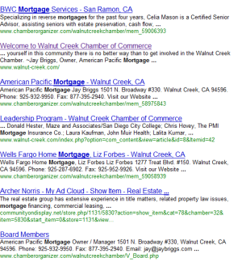
chamber economics – It does make sense to be a member!
www.chambereconomics.com
Become a member of the Chamber of Commerce and you become a member of the Area Search Engine that’s powered by Google®.

Slide 9
chamber economics – It does make sense to be a member!
www.chambereconomics.com
Chamber Delivers the Support
1-888-EzWay4U
www.FreeMembersSupport.com
Incredible Support Provided to Our Members
Marketing & Messaging
Traffic Catcher System Development, Mark LeBlanc Messaging Modules, Coupon Generation and Support Services all Included
My Ad Cloud Advertising System with Mobile Phone Update Interface and Ability to Link with PayPal or Google Checkout
Launch
Custom Domain Name Services (Included with Membership)
Area Search Engine Integration with Google®

Slide 10
chamber economics – It does make sense to be a member!
www.chambereconomics.com
Still Not Convinced?
“Average Cost” of Chamber Membership is $300 a Year or $25 per month.
Website might cost $500-$1000 to setup with help. Chamber membership will save you a whole lot of money.
A custom domain name might cost you $10-$30 a year. It’s 100% FREE when you join the Chamber of Commerce.
Website hosting might cost you $10 - $25 per month but that is ALSO INCLUDED with Chamber of Commerce Membership.
Advertising your business online to secure additional prospects could easily cost another $50 per month, but that is also FREE through the Chamber of Commerce.
1-888-EzWay4U
www.FreeMembersSupport.com
Using the lowest variables and NOT INCLUDING THE INITIAL SETUP COST OTHERS MIGHT CHARGE , you will SAVE $70 a Month. After the cost of Chamber Membership you will actually realize a GAIN OF +$45 per Month plus the value of so many other benefits not shown!

Slide 11

chamber economics – It does make sense to be a member!
www.chambereconomics.com
Consider Joining a Network of Chambers
Chamber Nation can assist your company in selecting the right Chambers of Commerce throughout the country to advertise your products or services. We can also attach you’re My Ad Cloud advertising system to each selected chamber saving you time with every Chamber you join!
Give us a call at
1-888-EzWay4U or (530) 283-5553
so that we can show you the power of Chamber Advertising.
You can also email Richard@ChamberNation.com for more information
Chambers of Commerce are the “Most Trusted” Source for Local Information.
National Banner Advertising is Also Available

